Slide 1
Unit 1. Computing Environments
1.3 Memory and Storage
RAM (DRAM, SRAM), ROM
Hard disk drive (HDD), removable HDD, SSD, optical media
Input and output devices

Slide 2
Where is the information stored on computers?
Memory is usually referred to as the internal devices which the computer can
access directly. This memory can be the user’s workspace, temporary data or
data that is key to running the computer.
Internal memory includes components such as registers (which are part of the
processor). There is also memory cache (which is external to the processor); this is used to store data which the processor will probably need to use again.
Storage devices allow users to store applications, data and files. The user’s data is stored permanently and they can change it or read it as they wish. Storage needs to be larger than internal memory since the user may wish to store large files (such as music files or photographic images).
Storage devices can also be removable to allow data, for example, to be transferred between computers. Removable devices allow a user to store important data in a different building in case of data loss.

Slide 3
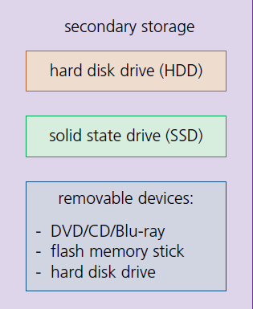
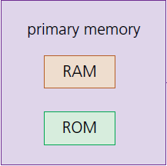
Types of Memory and Storage Devices

Slide 4
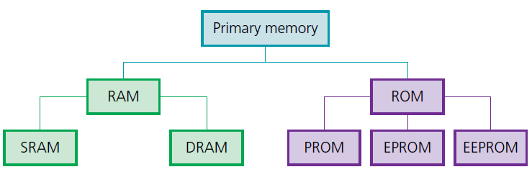
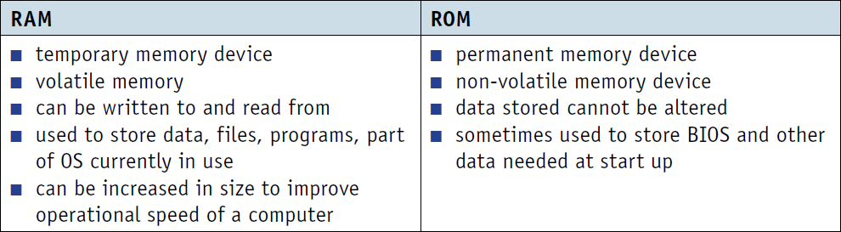
Primary Memory
random access memory
(RAM)
Read-only memory
(ROM)
Don’t need to know.

Slide 5
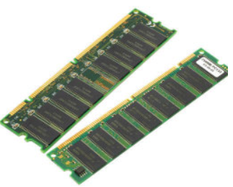
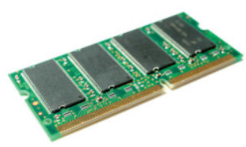
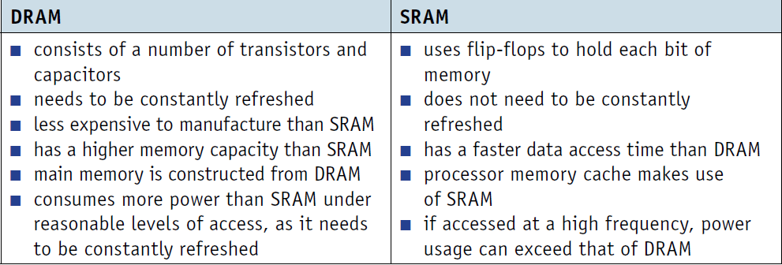
Dynamic RAM (DRAM) and Static RAM (SRAM)
https://www.youtube.com/watch?v=0rNEtAz3wJQ

Slide 6
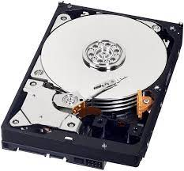
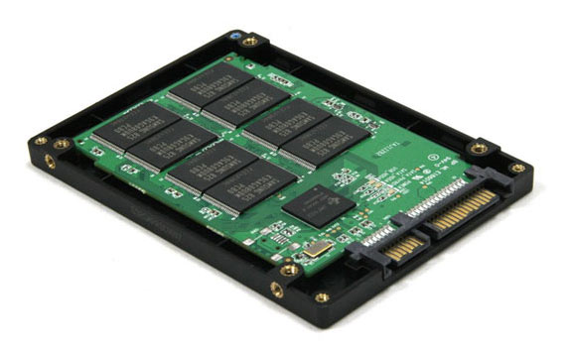
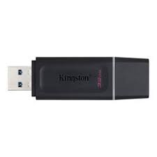
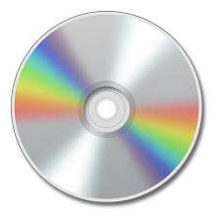
Secondary Storage Devices
Hard disk drives (HDD)
Data is stored in a digital format on the magnetic surfaces of the disks (or platters, as they are frequently called). The hard disk drive will have a
number of platters which can spin at about 7000 times a second. A number of read-write heads can access all of the surfaces in the disk drive.
Solid state drives (SSD)
An SSD performs the same basic function as a hard drive, but data is instead stored on interconnected flash-memory chips that transfer the data much faster than HDD. These flash chips are of a different type than the kind used in USB thumb drives, and are typically faster and more reliable. SSDs are consequently more expensive than USB thumb drives of the same capacities.
Removable hard disk drives are essentially HDDs that are external to the computer and can be connected to the computer using one of the USB ports. In this way, they can be used as back-up devices or as another way of transferring files between computers.
CDs and DVDS are described as optical storage devices. Laser light is used to read data from, and write data onto, the surface of a disk.

Slide 7
Virtual Memory
One of the problems encountered with memory management is a situation in which processes run out of RAM main memory. If the amount of available RAM is exceeded due to multiple processes running, it is possible to corrupt the data used in some of the programs being run. This can be solved by separately mapping each program’s memory space to RAM and utilising the hard disk drive (or SSD) if we need more memory. This is the basis behind virtual memory.
Essentially, RAM is the physical memory and virtual memory is RAM + swap space on the hard disk (or SSD). Virtual memory is usually implemented using in demand paging (segmentation can be used but is more difficult to manage). To execute a program, pages are loaded into memory from HDD (or SSD) whenever required.

Slide 8
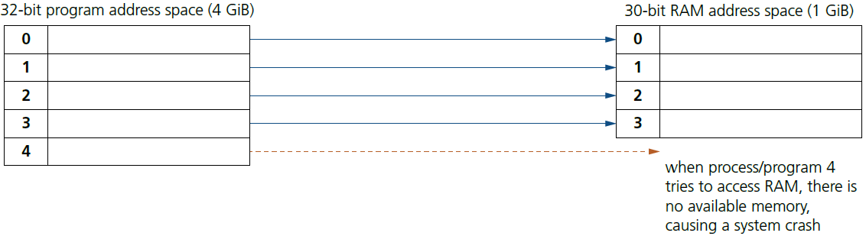
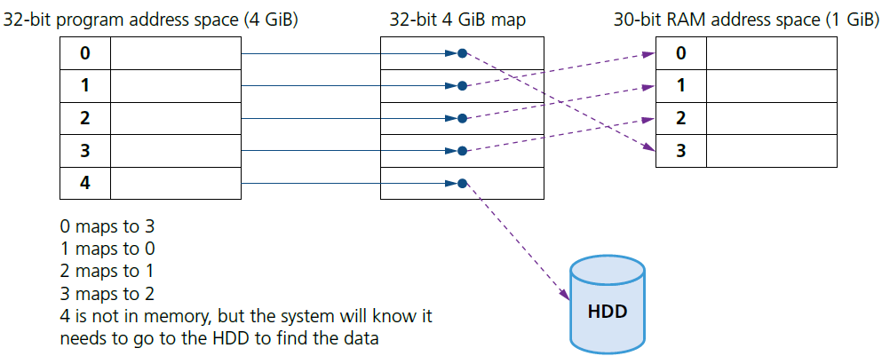
Virtual Memory
Without virtual management:
With virtual management:

Slide 9
Benefits and Drawbacks of Virtual Memory
The main benefits of virtual memory are:
» programs can be larger than physical memory and can still be executed
» it leads to more efficient multi-programming with less I/O loading and swapping programs into and out of memory
» there is no need to waste memory with data that is not being used (for example, during error handling)
» it eliminates external fragmentation/reduces internal fragmentation
» it removes the need to buy and install more expensive RAM memory.
The main drawback is:
when using HDD is that, as main memory fills, more and more data/pages need to be swapped in and out of virtual memory. This leads to a high rate of hard disk read/write head movements; this is known as disk thrashing. If more time is spent on moving pages in and out of memory than actually doing any processing, then the processing speed of the computer will be reduced. A point can be reached when the execution of a process comes to a halt since the system is so busy paging in and out of memory; this is known as
the thrash point. Due to large numbers of head movements, this can also lead to premature failure of a hard disk drive.

Slide 10
Practice Quiz
Computer Memory Quiz | 10 Questions (funtrivia.com)

Slide 11
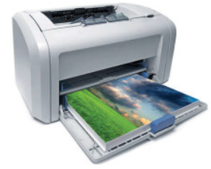
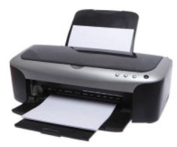
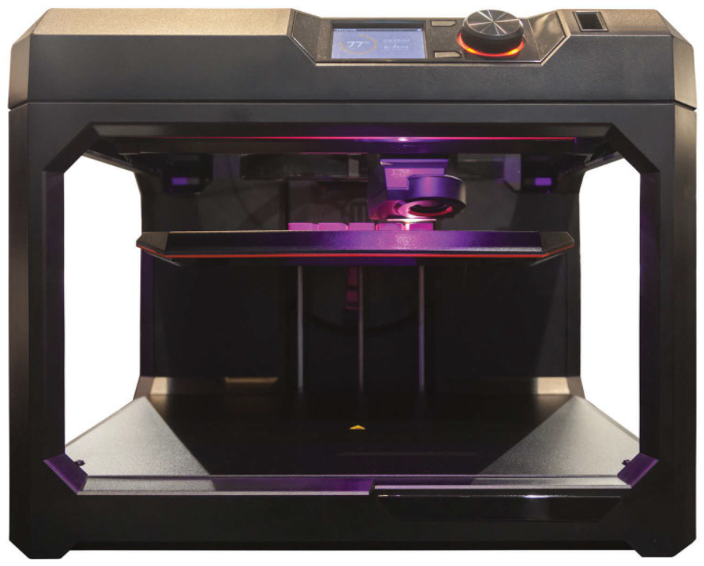
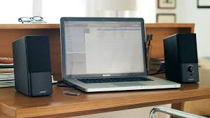
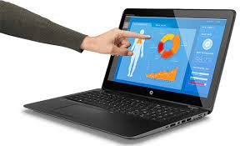
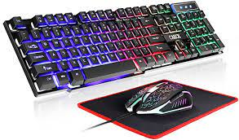
Input and output devices
Laser printers
Inkjet printers
3D printers
Speakers and microphones
Touch screens
Key board and mouse

